Slide 1
Regions of Geography
Formal, Functional, Perceptual Regions

Slide 2
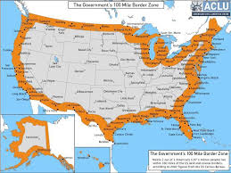
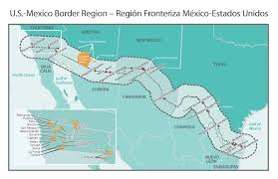
Formal Regions
An area that has set borders, entry or exit points, and can be exactly identified and mapped.
Country and State Borders, Military Zones, Checkpoints, in-zones, school zones.

Slide 3
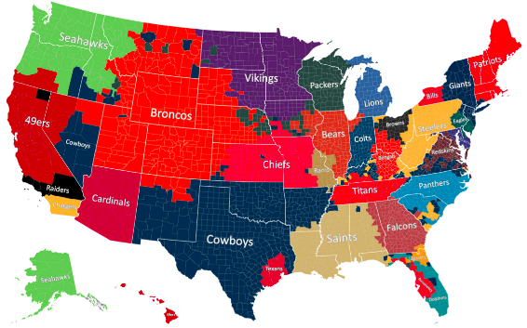
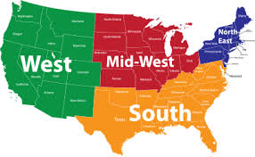
Perceptual Regions
Regions that are identified based on opinion, ideas, and human attitudes, and change due to your perception.
Cowboy Country, The South, Mid West

Slide 4
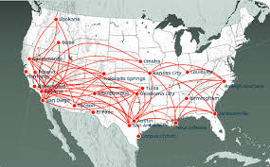
Functional Regions
An area that usually has a focal point due to communication, trade, or transportation.
Not a geographic area, but man’s idea
Pizza Delivery Areas
Cell Tower Coverage
TV and Radio Advertisements

